Slide 1
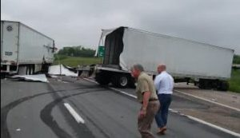
The Pennsylvania CMF Guide & PennDOT HSM Analysis Tool
The Pros and Cons

Slide 2
Pennsylvania CMF Guide & PennDOT HSM Analysis Tool
Who developed the PA CMF Guide
What is it
Why it was developed
Data and how to use it
Advantages (Pros)
Disincentives (Cons)
PennDOT Analysis Tool

Slide 3
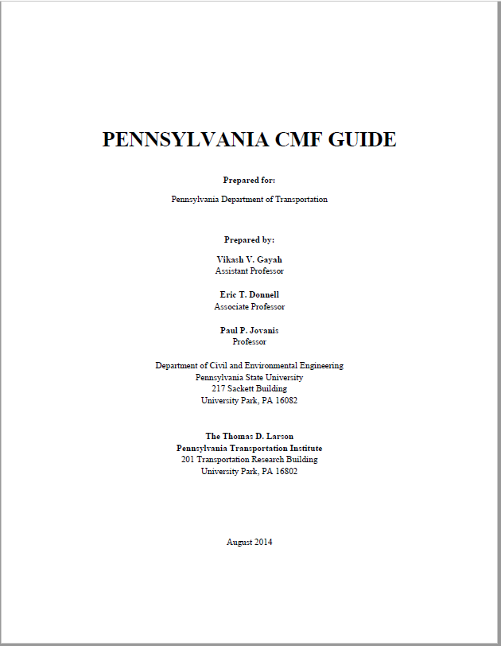
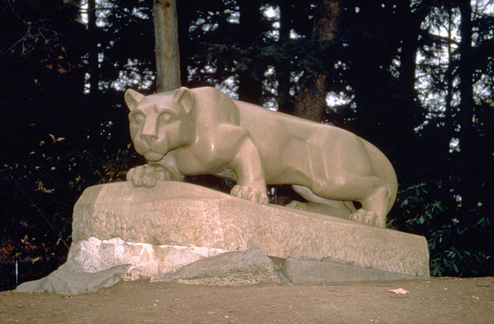
History
CMF Guide developed by
University
Completed August 2014
CMF Practitioners Guide developed by consultant firm
Completed April 2016

Slide 4
Pennsylvania CMF Guide
The Pennsylvania CMF Guide provides list of high-quality Crash Modification Factors appropriate for use in Pennsylvania
CMF data obtained mainly from FHWA CMF Clearinghouse website, www.cmfclearinghouse.com
The Practitioner's Guide establishes a consistent approach to the application of Crash Modification Factors (CMFs) within the context of the Highway Safety Manual (HSM) and the PennDOT HSM analysis tools.
Notes:
PG is intended to provide guidance on the use of the Pennsylvania CMF Guide and other available resources, and provide a roadmap for the
practitioner to use in identifying, selecting, and applying CMFs for use in estimating the safety performance of changes to Pennsylvania’s highway and street network.

Slide 5
Data and Use (Basics)
Assessing CMF Quality
Use rating system proposed by CMF Clearinghouse
Each CMF assigned score from 1 (worst) to 5 (best) stars based on (Same as CMF Clearinghouse):
Study design
Sample size
Standard error
Potential bias
Data source
Only 3+ star CMF included in guide and suitable for use in PA
Notes:
We mentioned that the guide contains only high-quality CMFs. To determine the quality of each CMF, we employed the rating system developed by the CMF Clearinghouse. In this system, each CMF is given a star rating between 1 and 5, where 1 is the worst and 5 is the best. This rating is based on five characteristics of the CMFs:
Study design (which we talked about earlier)
Sample size (number of crashes / locations considered)
Standard error of the CMF (lower is better)
Potential for bias in the estimates (perhaps due to data collection or other factors that might yield an inaccurate measure)
Data source (small geographic region vs. large geographic region)
Only CMFs rated a 3-star or higher are included in the guide. However, the guide contains a list of low quality CMFs and their sources for countermeasures that did not have higher-quality CMFs. This can provide an analyst with a reference if they are interested in these particular countermeasures. However, we do not recommend that these lower-quality CMFs be applied for safety applications in PA.

Slide 6
Data and Use
CMFs Categorized Into 19 Tables
Access Management
Advanced Technology and ITS
Alignment
Bicyclists
Delineation
Highway Lighting
Interchange Design
Intersection Geometry
Intersection Traffic Control
On-Street Parking
Pedestrians
Railroad Grade Crossings
Roadside Features
Roadway Features
Shoulder Treatments
Signs
Speed Management
Transit
Work Zones
*Does contain sections for CMFs equations and another section for Lower Quality CMFs
Notes:
The CMF guide is split into 19 tables…the categorization used here is the same as provided by the FHWA CMF Clearinghouse. This was done for consistency and to help an analyst look up the CMF in the clearinghouse if more detailed information is desired (e.g., if the analyst wants to find the exact reference that the CMF came from).
Note that individual countermeasures are not duplicated across tables and an analyst might have to check multiple tables to find a specific countermeasure. For example, CMFs for countermeasures at intersections with rail crossings can be found in both the table for Intersection Traffic Control and Railroad Grade Crossings.

Slide 7
CMF Tables
Each table provides information on the conditions for which the CMF applies, which include:
Roadway/area type
Crash type
Crash severity
Level of traffic (AADT)
Other implementation notes
CMFs should only be directly applied to the same conditions
CMFs might serve as a guide for other conditions
Notes:
The CMF tables are organized as follows:
They contain the name of the countermeasure, the conditions for which it applies, the point estimate and standard error, the star-rating and finally the states for which crash data were obtained to estimate the CMF.
The conditions are broken into five categories as shown here. The only one that might not be self explanatory is “Other implementation notes”. This contains countermeasure specific information that might influence where the CMF could be applied. Examples include: intersection types, number of lanes, speed limits, etc.
As discussed previously, the CMFs should only be applied to the SAME CONDITIONS as listed in the table.

Slide 8
Using the CMF Tables
Highlighted: recommended values
Bolded: values estimated using PA data
Notes:
Shown here is a portion of the CMF table. Note that it is broken to fit on the slide.
Notice the organization is as mentioned previously. For these CMFs, there are no “notes”.
(click) The highlighted values are provided whenever multiple CMFs exist for the same conditions. These highlighted values are the values that are recommended for use in PA. The other values are provided to show the range of potential values as another indication of the uncertainty associated with the CMF.
(click) You might also notice that some values are bolded (the one with AADT 574-20,784). These bolded values represent that the CMF was estimated using PA data. Note that the ones estimated with PA data are not always the “best” values as CMFs estimated from a larger geographic region and from more crash data might be more precise. However, this is provided in case the analyst would prefer to use a PA-specific CMF.

Slide 9
Advantages (Pros)
Uniform Statewide list of part D CMFs
Can be printed and used as a book
Used to develop consistent results in PennDOT’s HSM analysis tool
Shows higher quality CMFs (3 stars or higher)
Shows CMFs that used Pennsylvania data

Slide 10
Disincentives (Cons)
Outdated once it was published
Clearinghouse is always being updated
Not web based and as easy to access as
Not as easy to use as CMF Clearinghouse
Does not include the CMF ID numbers
Harder to reference more information about the CMF(s) selected
Expensive to develop
Includes some CMFs that aren’t used in PA
HAWKS, pelican to puffin crossings
No Part D CMFs were created by Penn State for the CMF Guide

Slide 11
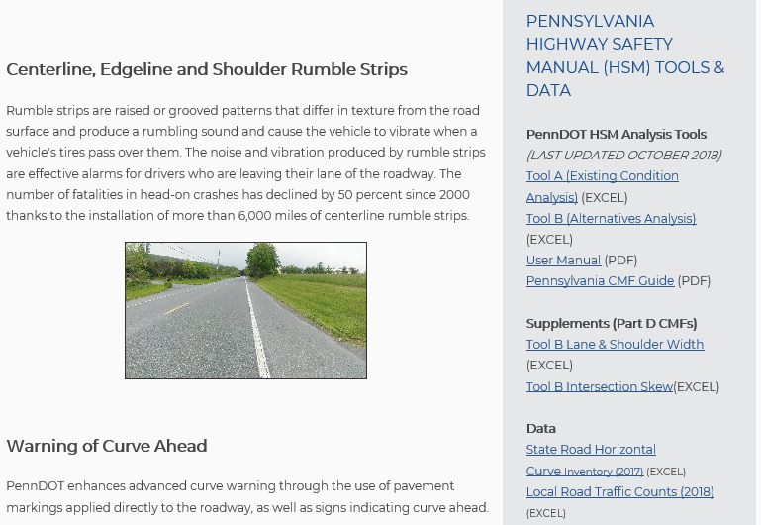
PennDOT HSM Analysis Tool
PennDOT has HSM Analysis Tools A & B available at: https://www.penndot.gov/TravelInPA/Safety/Pages/Safety-Infrastructure-Improvement-Programs.aspx
Tool B contains the part D CMFs for alternatives analysis
PA CMF Guide
Part D CMF tools for lane & shoulder widths and adjustments to intersection skews (Cross-sectional)
Notes:
Users must complete a Tool A analysis 1st
The user then uploads their Tool A file into the Tool B file
Once “Tool A” file is uploaded, you can then move onto alternatives analysis

Slide 12
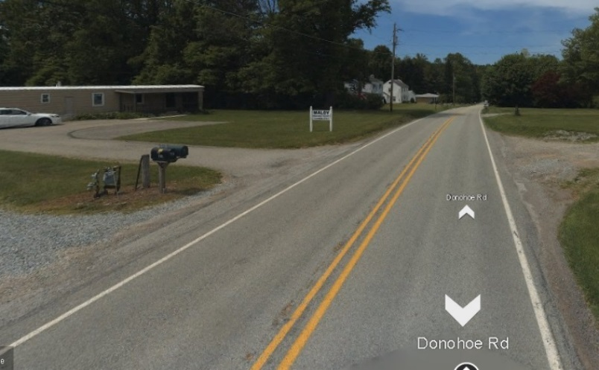
Small to Moderate Scale Example
For a small to moderate scale site Safety Assessment use PennDOT’s HSM Analysis Tools A & B or other spreadsheet tool options.
Rural Collector in D-11, Beaver County
Notes:
Main point of Design PM meeting is the design exception example.

Slide 13
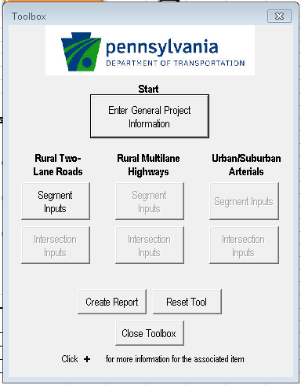
Use PennDOT HSM Analysis Tools A & B
Existing Conditions:
Facility type: Rural Collector (rural 2 lane roadway)
District 11-0 Beaver County
Length: 2 miles AADT: 4,500
Total Paved width: 22 feet
Lane width: 10 feet
Shoulder width & type: 1 foot / paved
Warning signs: not present
Constraints:
ROW issues only allows for 26 feet of paved roadway width
Cost to obtain additional 4 feet of ROW is $350,000
Need to justify design exception for narrow shoulders
Minimum AAHSTO Green Book Design Criteria:
Rural Collector- (PennDOT DM community collector)
Lane width: 11 feet
Shoulder width & type: 4 feet / paved
Warning signs: not required

Slide 14
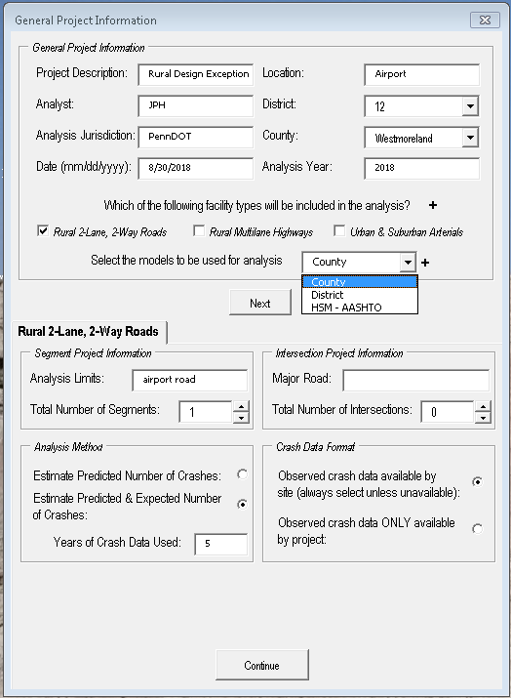
Apply Data to SPF
Do not change the Blue data if you are using “PA SPFs”. Simply put, “Ignore the Blue entry fields”.
Notes:
Pick your best model option. In Pennsylvania it is always county.
Tool can be used by other states since it does have the national models
Do not enter anything into the blue when using PA SPFs.
It will change your answer and affect the accuracy.
The change in these conditions will be accounted for in the part D analysis using cross-sectional part D CMFs.

Slide 15
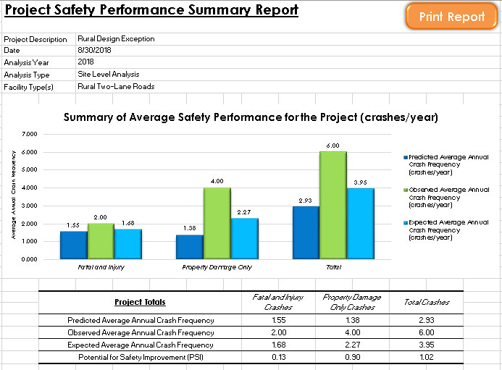
Crash Frequency Reports (Part C Base model)
Notes:
Easier to explain if you multiply by 10.
Say over a 10 year period we would expect to have around 16.8 fatal & injury crashes compared to the observed trend of 20.0 F&I crashes over a 10 year period. The predicted model for similar facilities is 15.5 F& I crashes.

Slide 16
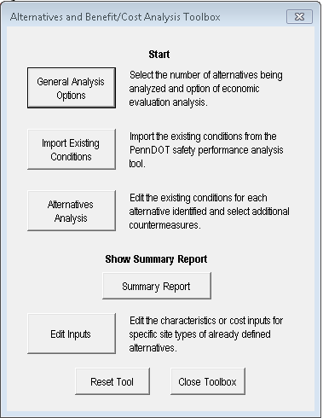
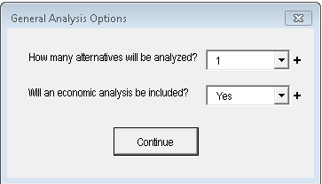
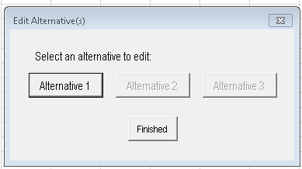
Evaluate Safety Improvement Options -HSM part D Analysis))
Project Options:
26ft wide: 11ft ln/2ft shldr
26ft wide: 12ft ln/1ft shldr
30ft wide: 11ft ln/4ft shldr (Design standard)
Time to use Tool B
Can Evaluate 3 options
3 - CMFs per Alternative option
Has several known CMFs
Can add up to 3 user defined CMFs
Benefit Cost Analysis (BCA)
Use lane & shoulder width supplement tool
Upload your “Tool A” file (part C analysis)

Slide 17
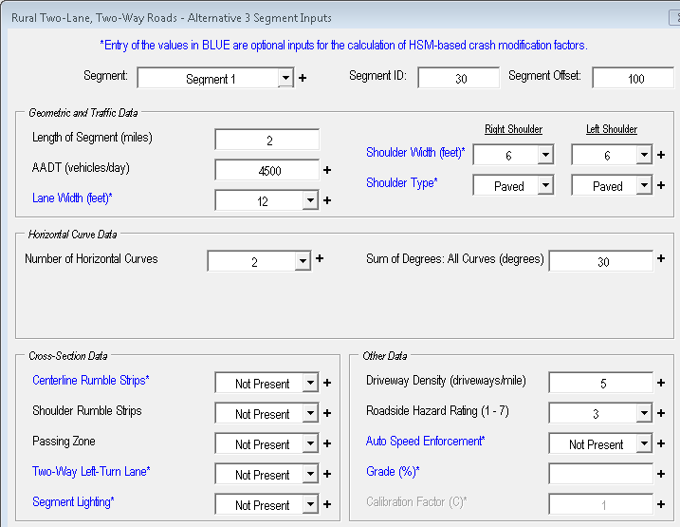
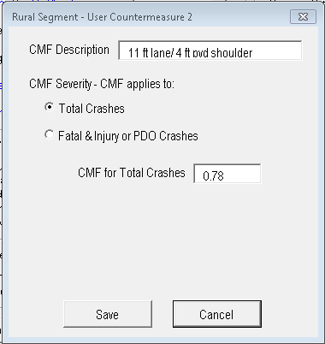
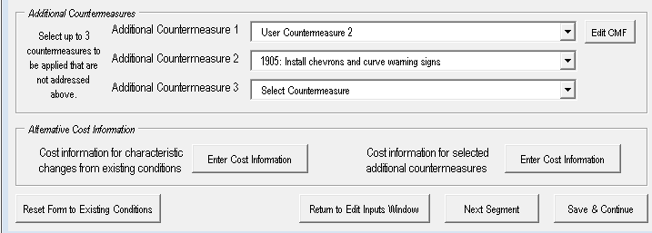
Enter Part D Analysis Data
1. Data Pulled from “Tool A” file
3. Customize User Countermeasures here (see next slides)
2. Select Countermeasures here
Notes:
The PennDOT HSM Analysis Tool now has CMF ID numbers for part D CMFs to check validity of CMF selected for project.

Slide 18
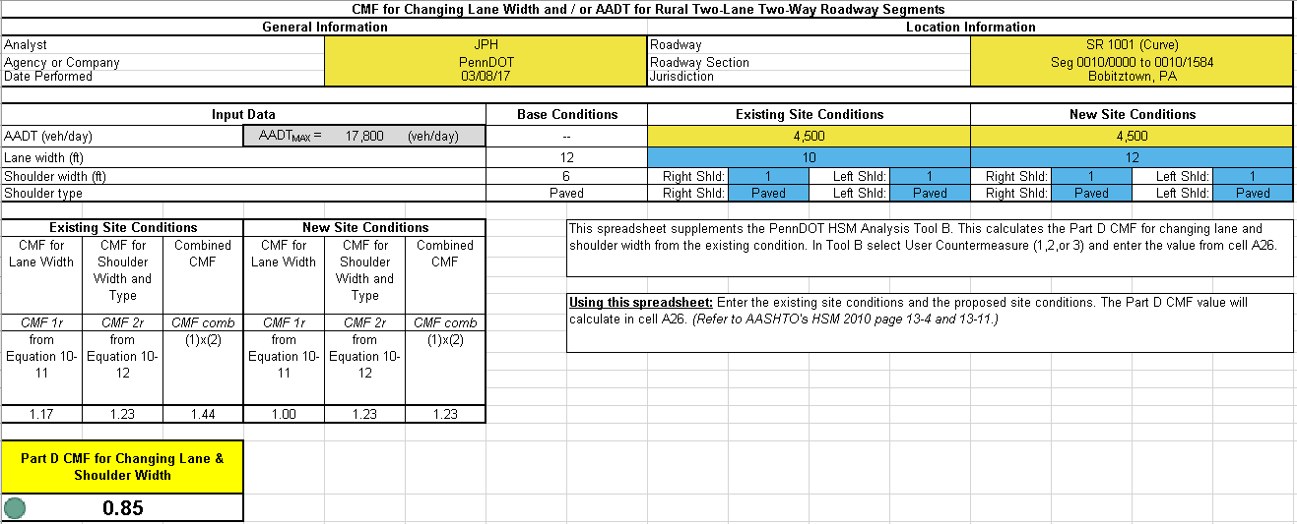
Shoulder & Lane Width CMF for Part D Analysis
<1.0: Crash reduction
=1.0: No change
>1.0: Increases crashes
Optimal lane & shoulder width with 26 feet of total pavement width
Notes:
This is the optimization of the 26 feet wide pavement which only involves where you will paint your new edge line.
You would also need to complete this for the design minimum option which comes 11feet/4feet which calculates to a CMF of 0.78.
Although the design minimum has the best Part D CMF value, it does cost a lot more and involves acquiring right away which could delay the project.
The next slides cover the BCA.

Slide 19
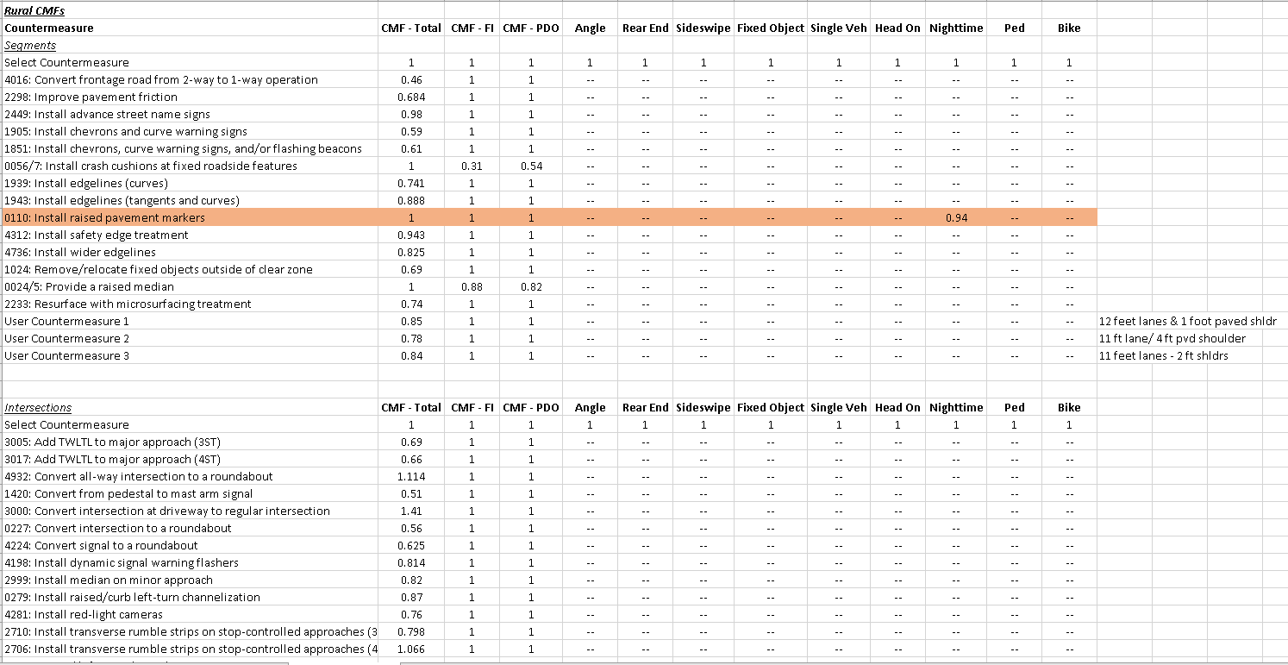
CMF List in the Tool
Notes:
We have over 80 Part D CMFs loaded into the Tool B.
You can add up to 3 customized CMFs
If necessary, you can go into the spreadsheets and change the Countermeasures in the spreadsheets if certain CMFs are not being used

Slide 20
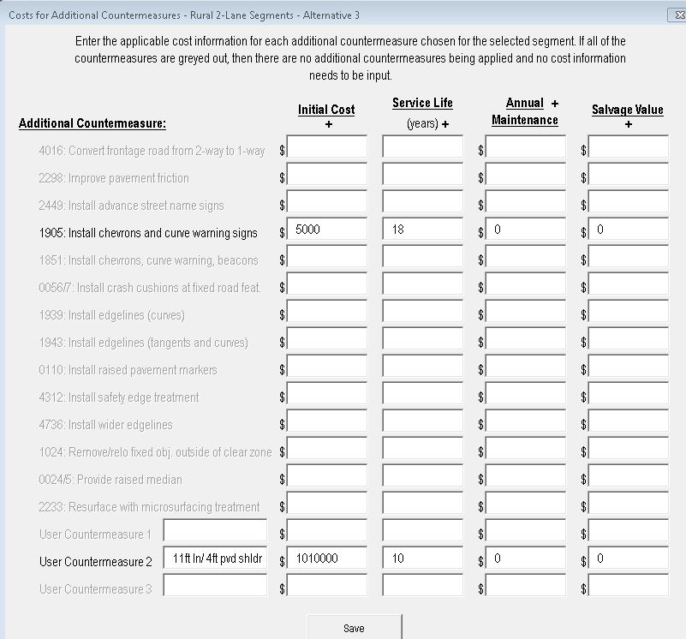
Benefit Cost Analysis
Add necessary costs and service life for a BCA
Enter one at a time for each Option (Alternative)
Life cycles for different countermeasures can be different.
Notes:
Shows option #3, the Design Minimum Criteria.
CMF ID #1905 will be changed to CMF ID # 2436 or #2438, “Install chevrons signs on horizontal curves” in next tool update (2019)
#2436 CMF = 0.96 for all crash severity, for all roadway types, on 2-lane undivided rural roadways
#2438 CMF = 0.84 for F&I crash severity, for all roadway types, on 2-lane undivided rural roadways
#1905 CMF = 0.592 for all crash severities and types, but only for freeways and expressways

Slide 21
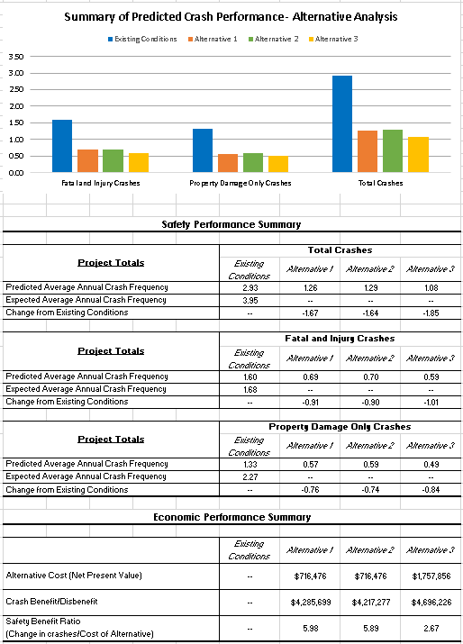
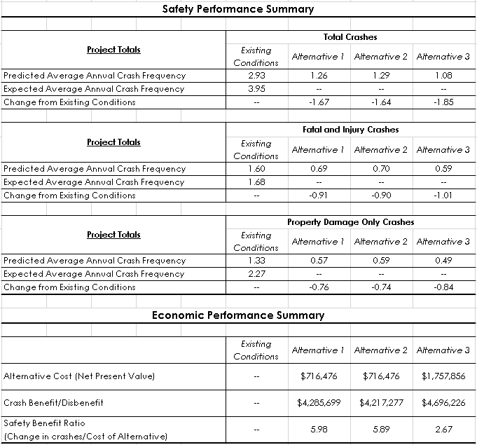
Summary of Project options
Justifies DE
Notes:
All options include curve warning signs for $5,000
Option 1: 26 feet wide [11ft lanes w/2ft shoulders = $415,000 w/ 10 year service life
Option 2: 26 feet wide [12ft lanes w/1ft shoulders = $415,000 w/ 10 year service life
Option 3: 30 feet wide [11ft lanes w/4ft shoulders = $1,015,000 w/ 10 year service life
Requires $250K more for widening & another $350K for ROW
Option 1 is the best option due to the BCR being 2.2 times better than the Design Minimum option. It will likely be quicker to build since there will not be any ROW issues thus having a quicker impact on safety. This would justify the design exception from a safety aspect.

Slide 22
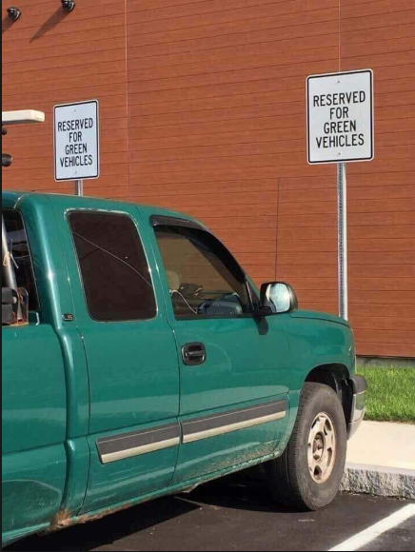
Questions

